Slide 1
OVFA ambassador Program

Slide 2
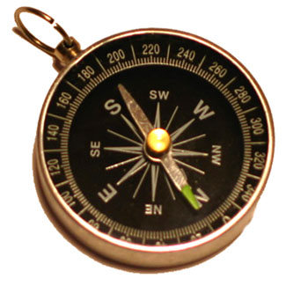
Application process
Completed Application
Letter(s) of Recommendation
Interview
Orientation
Notes:
Review of each application will be done by a committee. Each applicant will be required to present a completed application, letter of recommendation, undergo an interview and complete the OVFA Ambassador Orientation before official becoming an Ambassador. Ambassador application will be accepted all year but interview will only happen during the first day of the OVFA Annual Conference in June. Approved applicants will be announced at the Conference Banquet. Orientation will be schedule once applicants have been approved.

Slide 3
Orientation & Training
Orientation
History of OVFA
Bylaws and Policies
OVFA Benefits
Duties/ Responsibilities
Expectations
Training
Uniform
Travel
Training
Leadership
Communication
Presenting
Notes:
Orientation will consisted of the following for each Ambassador
Teach a brief history of OVFA
Go over Bylaws and policies and the benefits we offer as an organization
Teach the Duties and responsibilities of an ambassador
The expectations and conduct that is expected
Set aside an hour of training at the annual conference
Uniform- times to wear and manner it should be worn
Fill out all additional forms
Training will be divided between these three areas
Leadership
Communication
Presenting
Ambassadors will be required to attend a certain amount of training each year to ensure consistence in the program.

Slide 4
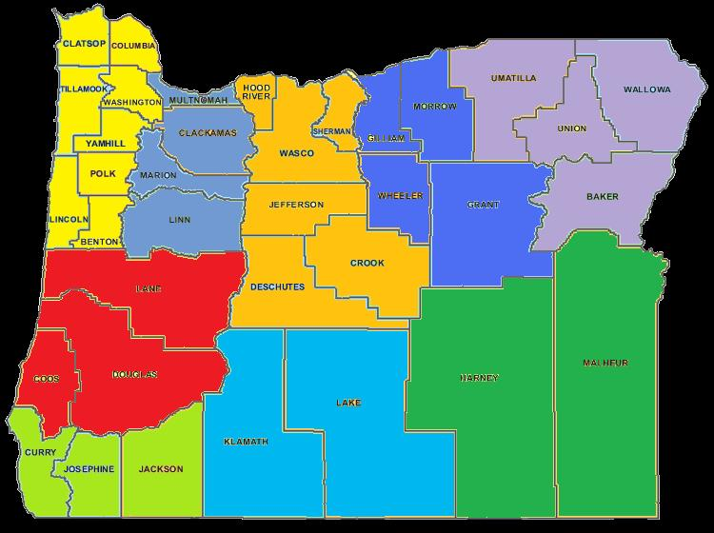
9 Ambassador Regions
1
9
4
8
5
2
7
6
3
Notes:
Region 1
Clatsop
Columbia
Tillamook
Washington
Yamhill
Polk
Lincoln
Benton
Region 2
Lane
Douglas
Coos
Region 3
Curry
Josephine
Jackson
Region 4
Multnomah
Clackamas
Marion
Linn
Region 5
Hood River
Wasco
Sherman
Jefferson
Crook
Deschutes
Region 6
Klamath
Lake
Region 7
Harney
Malheur
Region 8
Gilliam
Morrow
Wheeler
Grant
Region 9
Umatilla
Union
Wallowa
Baker

Slide 5
Ambassador Structure
Chain of Command
OVFA Executive Board
Region 1 Ambassador
Region 2 Ambassador
Region 3 Ambassador
Department Delegate
Department Delegate
Department Delegate
West Ambassador Director
East Ambassador Director
Region 6 Ambassador
Department Delegate
Region 7 Ambassador
Department Delegate
Region 8 Ambassador
Department Delegate
Region 9 Ambassador
Department Delegate
Region 4 Ambassador
Department Delegate
Region 5 Ambassador
Department Delegate
Notes:
The Ambassador is structure so that: OVFA Board who will oversee the entire program, Two Directors who will act as Advisors to the Ambassadors . Each Director will have a group of ambassadors underneath them. The Directors will conduct trainings for their assign groups and ambassadors will report monthly to their assigned Director. Each Ambassador will have an assigned region that they will be responsible for. Each department with in the region will have a delegate that communicates with their ambassadors, Director and the OVFA Board.

Slide 6
Duties and Responsibilities
Duties:
Represent OVFA as a point of contact to member and non-member departments
Represent OVFA at regional functions
Promote OVFA
Attend and setup OVFA Conference
Responsibilities
Report activities
Track membership
Create partnerships
Monthly report to Ambassador Director
Report quarterly to OVFA Board meeting
Promote sale of merchandise

Slide 7
Expectation
Complete the Annual Ambassador Workshop
Maintain a positive image
Be knowledge of OVFA
Attend 4 OVFA Board meetings a year
Complete 1 member & 1 non-member visit monthly
Attend OVFA Conference
Assist OVFA Board in assigned duties
Maintain their good standing in home department

